Slide 1

Notes:
Hi everyone! I’m Caleb, and this is our first tech talk since the event that must not be named. Please feel free to shout out questions as you have them, but I will also have some time for them at the end.
This talk is called Postman…
Wait, there was something else, too… ummm…

Slide 2

THE LEGEND OF
BREATH OF THE API
Notes:
This is my talk, The Legend of
No, that’s not right either.

Slide 3

Not just the
Notes:
Nope, nope, nope.

Slide 4

And
API Testing Made Easy
Notes:
There it is.

Slide 5
the
Caleb Meyer
Senior Software Engineer
Dad of the Millennium (Falcon)
Arbiter of Documentation
Script Ninja
Veteran Mercenary
Notes:
Hi, I’m Caleb! I love board games, piano music, and espresso. I also love titles. You should give your coworkers some titles too. All of these were given to me by my coworkers.
But today my title is expert slide developer and novice public speaker, so let’s continue with what you’re going to learn in today’s talk.

Slide 6
History
Basics
Requests
Covered Today
Collections
Variables
Testing
Insomnia
Notes:
Today we’re going to cover a lot, including the what, how, and why of Postman and Insomnia. I'll start with postman and then talk about how Insomnia differs.

Slide 7
Postman started as
a Chrome Extension
Side Project
Notes:
Today postman is a whole separate application with a suite of services attached. But it started as a lowly chrome extension.
Original developer Abhinav Asthana says in 2012 he was a coding intern whose job was to take APIs and convert them into a shareable format. He kept running into the same problem over and over: it was too hard to figure out how APIs worked.
And what do good programmers do when something is hard? He wrote some code to scratch that itch and announced it as an answer on StackOverflow.
After the first half a million users, Abhinav realized that there was a business opportunity here and created a startup with his fellow intern. That turned into the postman we know and love today.

Slide 8
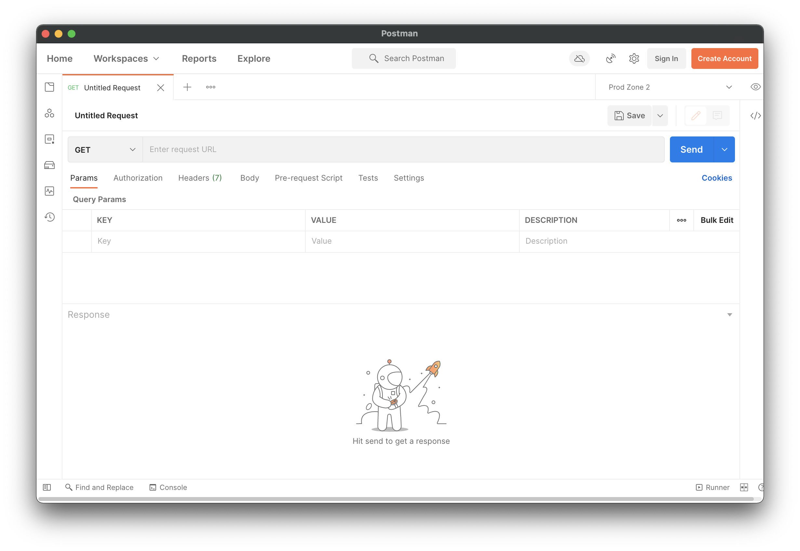
Too bright!
Notes:
So, let’s jump into the app itself.
But… argh… As you all certainly know, most developers are secretly vampires, and those that aren’t vampires are energy conscious, so we are going to have to get rid of this brilliant white monstrosity. Head into your settings and change that theme to dark!

Slide 9
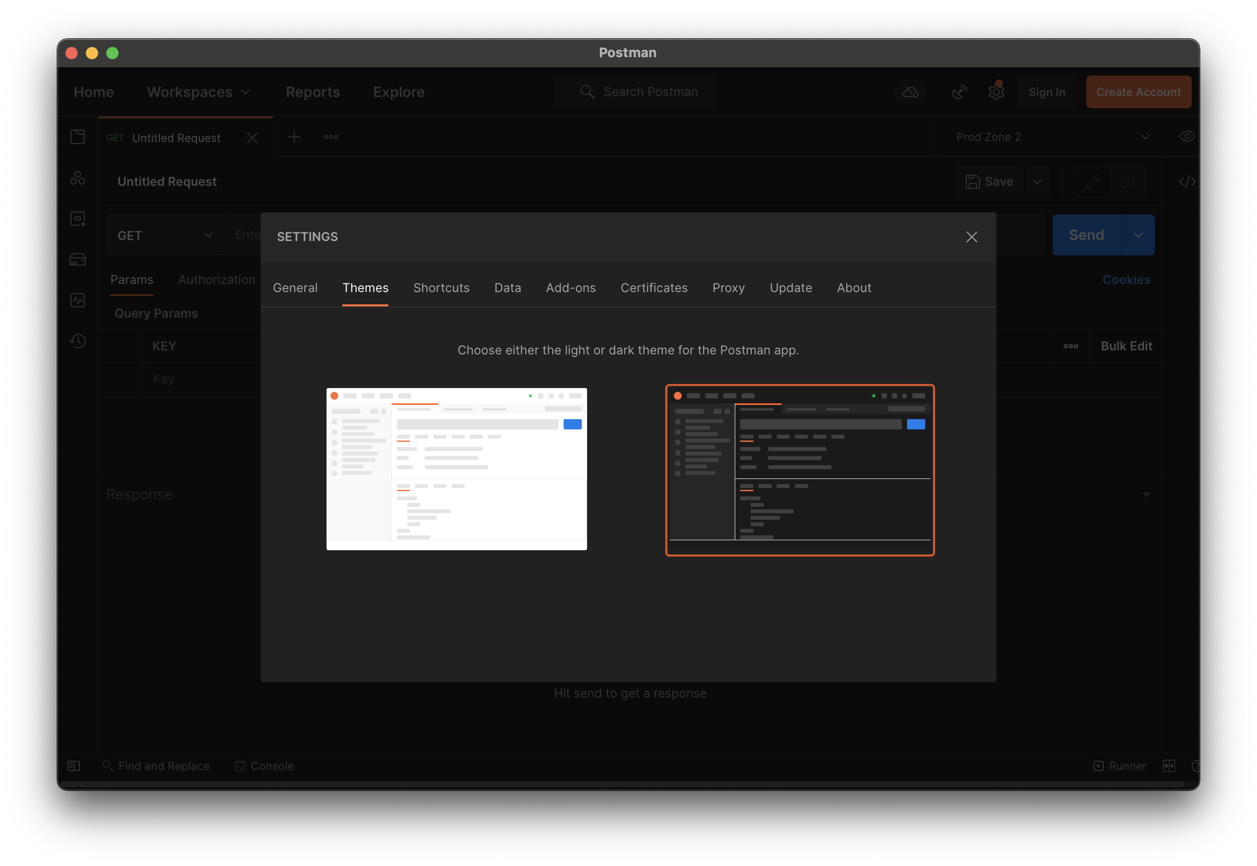
Much Better!
Notes:
Whew. That was a close one. This looks much better. I’ll note that I’m running this on my work mac, but postman is completely cross platform. You can run it on whatever computer you have.

Slide 10
h t t p : //
y
p
e
r
e
x
t
ransfer
r
o
t
o
c
o
l
Notes:
Okay, now that we’ve got that all fixed, let’s cover some basics. Let’s start with HTTP. The hyper text transfer protocol.
HTTP is a protocol that tells us how we can talk to web servers by transferring hyper text, text documents like hyper text markup language, cascading style sheets, javascript, and much more.

Slide 11

Hello, I want to
GET /tweets
Notes:
So, let’s talk to a web server. The first part of interacting with a webserver is that you make a request. For example, if you’re talking to twitter’s API, you might ask for some tweets.
Once you’ve made the request, the webserver must decide how to respond.

Slide 12

GET /tweets
401 Unauthorized
Notes:
It could say “I’m sorry Dave, I’m afraid I can’t do that”

Slide 13
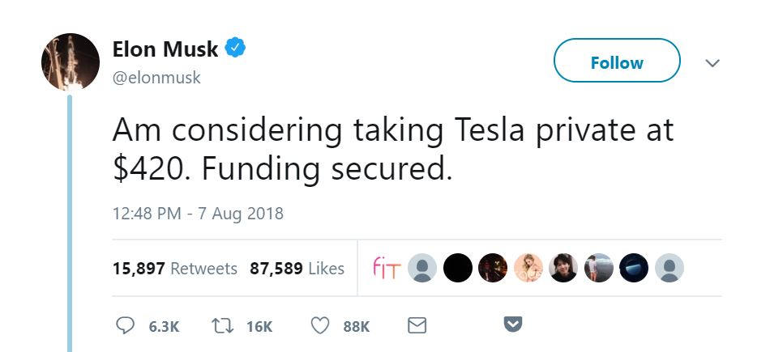

GET /tweets
200
OK
Notes:
Or it might come back with your requested tweets. Either way, there are four important parts here, and a few less important parts we haven’t shown yet:
the method
the url
the response code
the response body, which is optional
Let’s talk about each of these in turn.

Slide 14
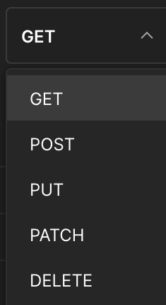
HTTP
Methods
Notes:
The first part of the request is the method. In Postman, you can change the method using this handy dropdown. There are more methods than I’ve shown here, but these 5 are the most used.
GET requests get something.
POST requests create things.
PUT requests are to replace things. They're mostly used to update.
PATCH requests are to make smaller updates, such as only changing one part of a giant JSON object.
DELETE requests delete. You tell the server which thing you want gone, and it deletes it for you.

Slide 15
The
URL
Notes:
The second part of a request is the URL or Uniform Resource Locator. You may also hear this called an Address, URI, or Route. Given the number of postal terms we use, I think you can see why this app is called Postman.

Slide 16
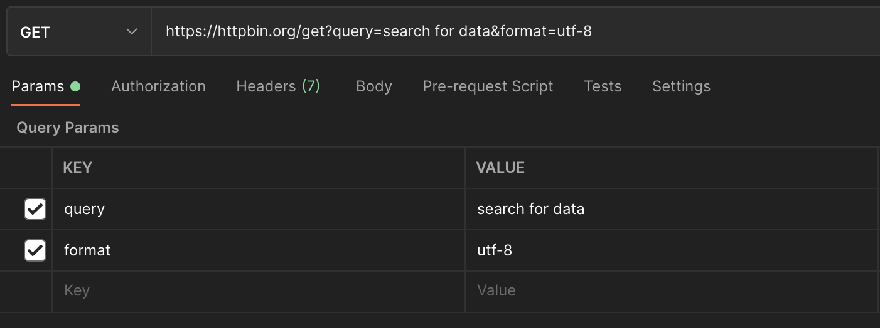
Protocol
Domain
Path
Query Parameters
Notes:
But URLs can certainly be more advanced. Let’s take a look at another one. This is making a more interesting request. We still have a protocol and domain, as before, but now we also have a path and two query parameters.
The path or endpoint of a request tells the web server which resource to look up. Here we’re going to the resource at /get, but you’ll often see APIs expressed like /core/v1/tenants, which says we’re looking up tenants in the Core API version 1.
I’m sure you’re looking at this screenshot and wondering what the other tabs do, so let’s quickly go over them:

Slide 17
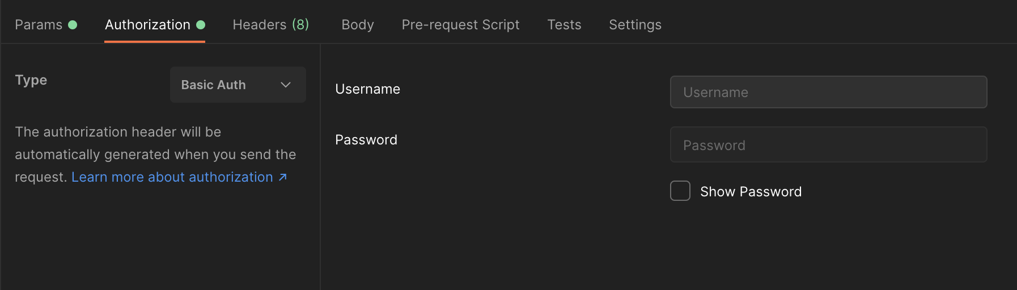
Authorization
Notes:
Authorization is how you avoid getting those dreaded 401 unauthorized errors. You can provide a username and password, a boatload of information for OAuth 1, a single JSON Web token for OAuth 2, or a couple other types.

Slide 18
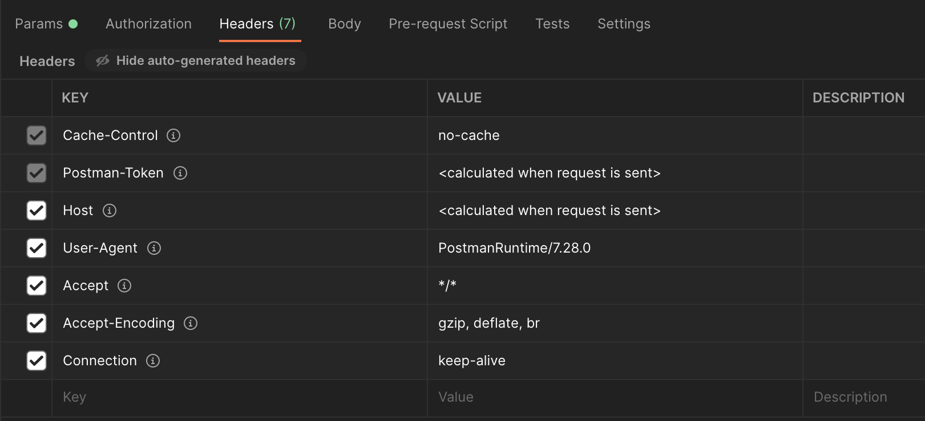
Headers
Notes:
Headers are kind of like the invisible settings of a request. They tell the server things about you, the client. They also let the server know what you want back. Here, it says don’t give me a cached response, but I’ll accept any file type, even if it’s zipped up, and don’t close our connection after this first request.

Slide 19
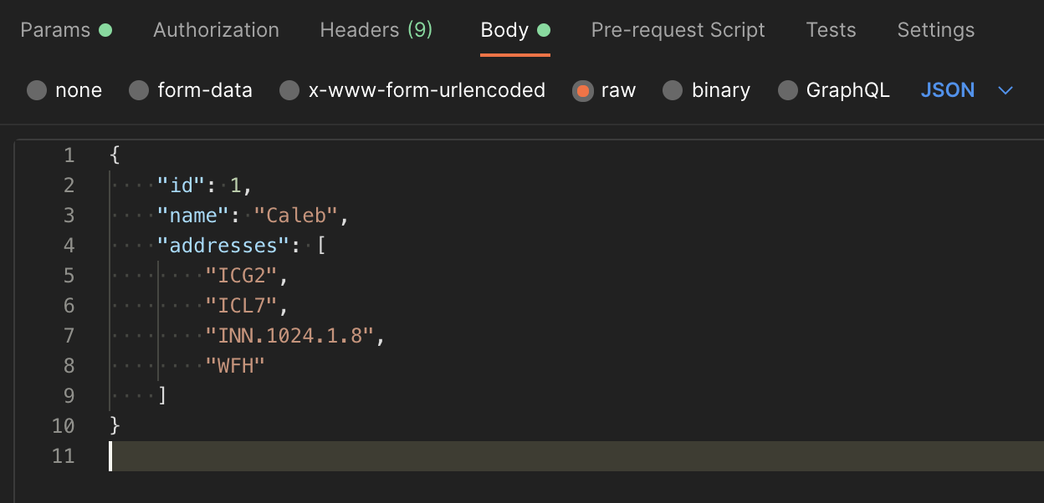
Body
Notes:
The body of a request is only needed for the P methods: POST, PUT, and PATCH. Most of our APIs only accept JSON or GraphQL, but in the wider world, you’ll see form submits that are key value pairs and even the occasional XML.
The last three tabs here are unique to postman and very powerful. The pre-request script is some Javascript that can read and change any part of your request. The Tests could and maybe should have been labeled the Post Request script. They can read and do things with any part of your request or the response. Settings lets you change how redirects and auth are handled, among other things.
And now, the moment you’ve all been waiting for…

Slide 20

Notes:
Let’s press the Big Blue Button

Slide 21
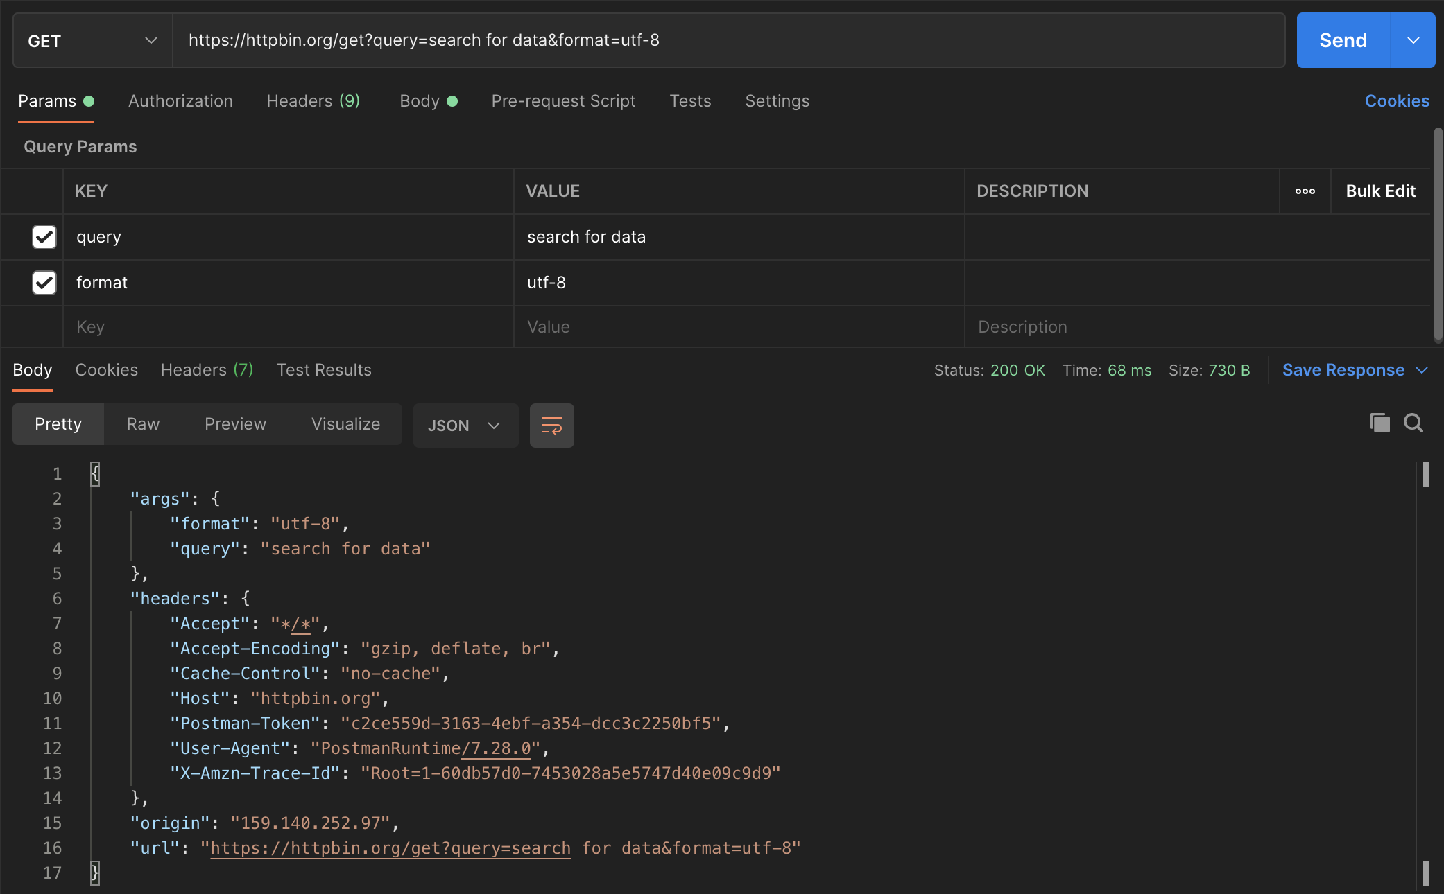
Get a Response
Make a Request
Notes:
When you press the button, the bottom half of your window populates. That section is reserved for the response. It can be a lot of information, so let’s break it down.
Taking up the biggest part is the response body.
The pretty tab shows JSON, XML, and other structured formats pretty printed and syntax highlighted.
Raw shows you just the text (or the bytes) of the response.
Preview shows you rendered html.
Visualize is an advanced feature that lets you supply a handlebars html template and use the response data to fill it out. This lets you see charts and graphs. I’ve never seen anyone use it, because if you’re making charts and graphs, you should upgrade to a full-on webpage.
Over on the right, you can see the response time and how many bytes were returned. You can also save the response to a file. And finally, you can see the fourth major part of an http request and response we mentioned earlier, the response status code.

Slide 22
302 Found
100 Continue
Response
Status
Codes
400 Bad Request
504 Gateway Timeout
204 No Content
404 Not Found
401 Unauthorized
201 Created
503 Service Unavailable
500 Internal Server Error
200 OK
Notes:
I will admit I have to look up all but the most used of these status codes every time. I like MDN or httpstatuses.com for them. You don’t need to memorize these, and there’s lots more than I’m showing here, including the very important 418 “I’m a teapot” code.
Fortunately, they’re categorized by their hundreds place.
The 100s are all informational statuses. I’ve never seen one because they’re mostly used for low level plumbing.
The 200s are all the success codes. 204 No Content means you don’t have to look at the response body, because it’ll be empty. It’s typically used for Updates and Deletes.
The 300s are all the ”wrong number” codes. 302 Found responses include a header called Location that you’re intended to visit instead of whatever you asked for, and browsers will automatically redirect you.
The 400s are the “you done messed up, A-A-Ron!” codes. It means something the client did was wrong, and you shouldn’t send that request again without changing it somehow.
The 500s are the “Oops” codes. It means the server is having some kind of trouble that prevented it from fulfilling your request.

Slide 23
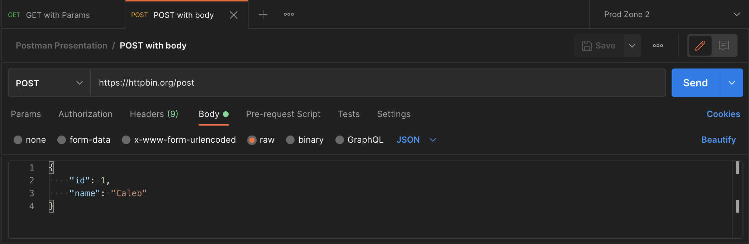
Tabs
Notes:
Okay, so you’ve made your first request, gotten your tweet back, and… crap.
It’s got a typo. Now you need another request to fix it. Good thing postman has tabs! So, you open up a new tab. And another. And another.

Slide 24
Tabs
Notes:
What do you mean I have too many tabs open? I can sort of read what they all say… Oh crap, did I close that one? I wanted to save it!
Good thing postman has my back.

Slide 25
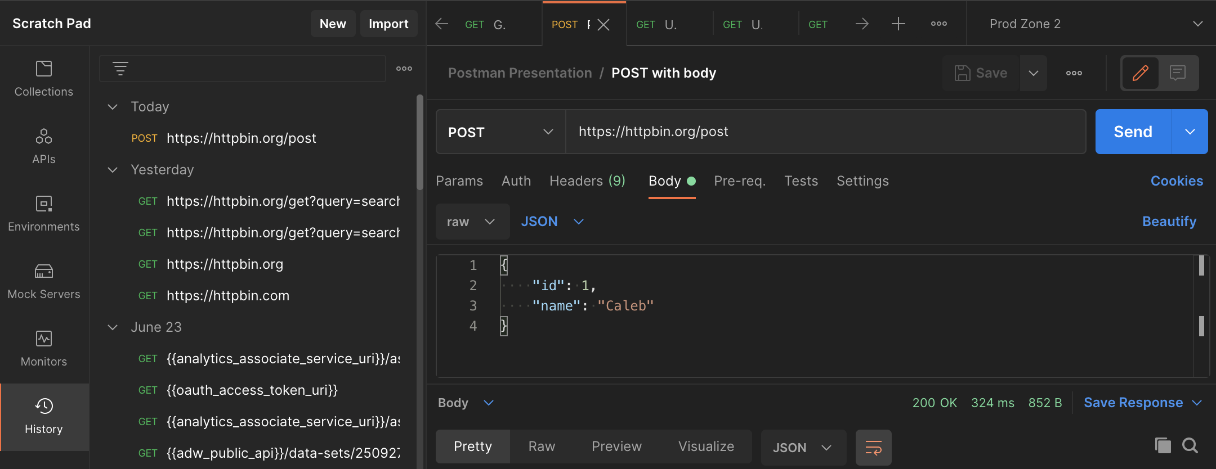
History
Notes:
Postman keeps a history of every request you make, so it’s easy to recall older requests. But if you make a certain request or set of requests a lot, it’s time to turn to collections.

Slide 26
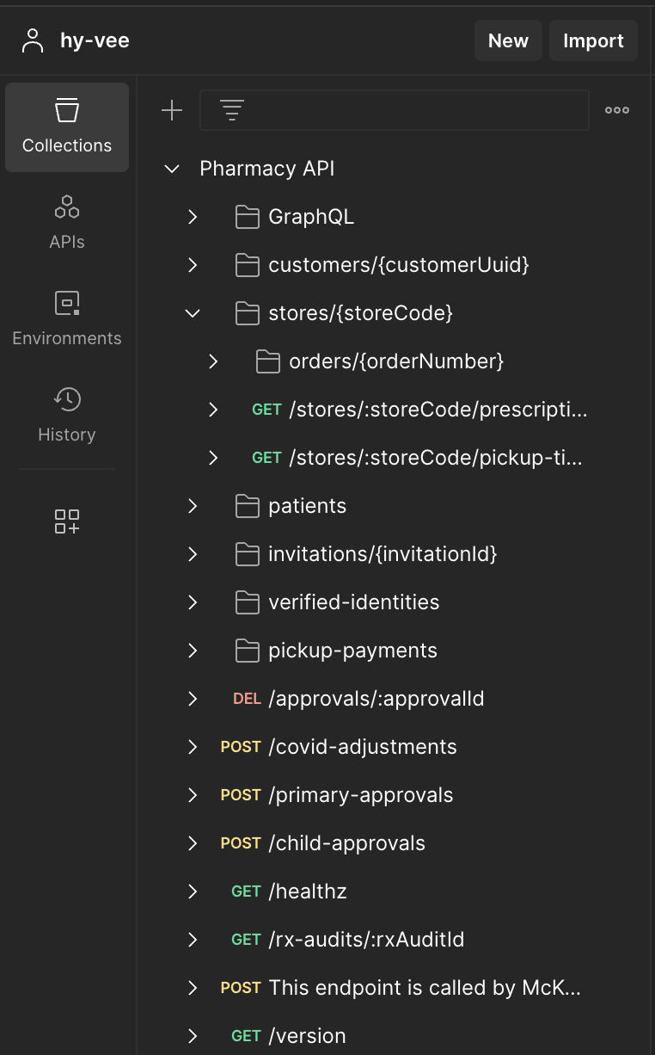
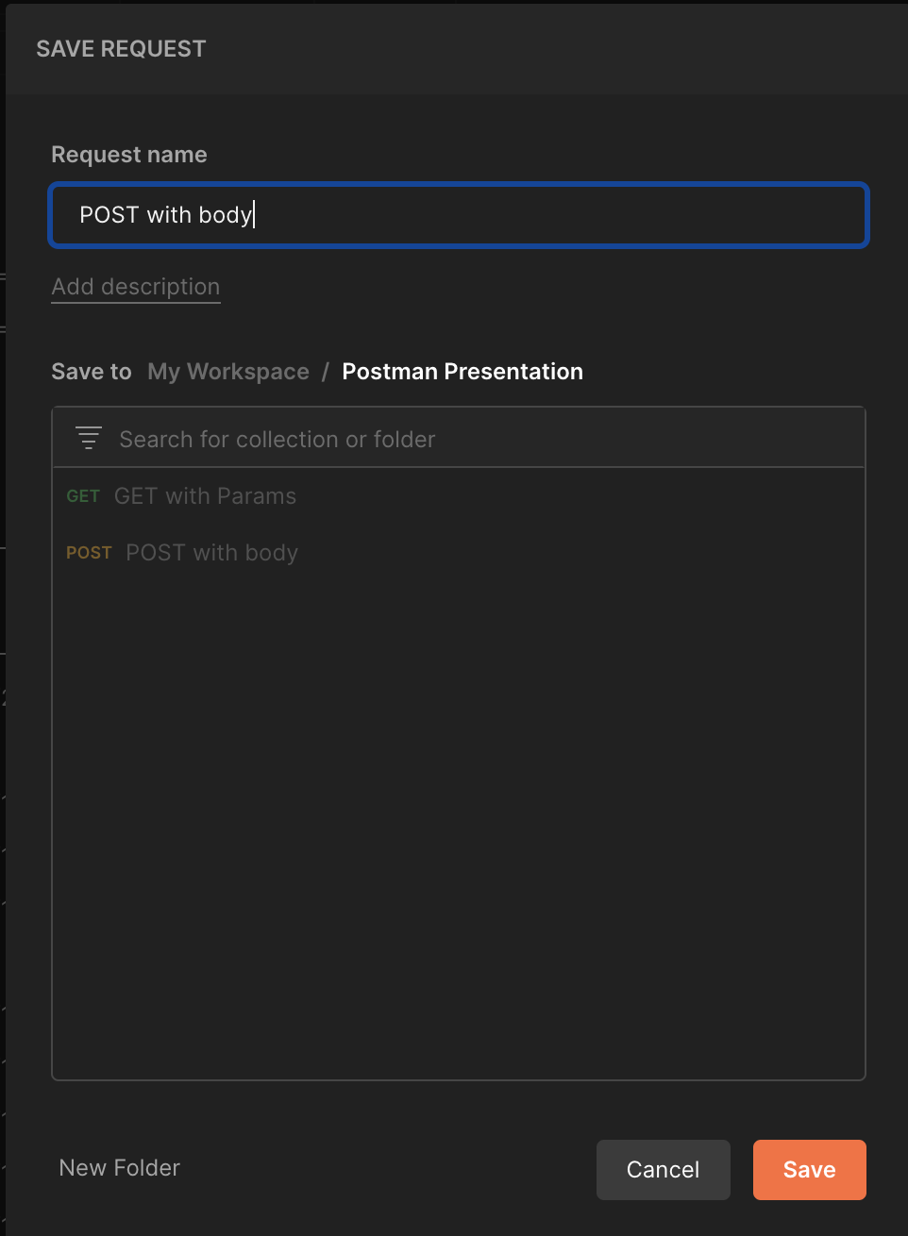
Save
a
Request
To
a
Collection
Notes:
Postman lets you save requests, and group multiple saved requests into a collection. Collections can have folders, which means you can get as many layers of nesting as you need.

Slide 27
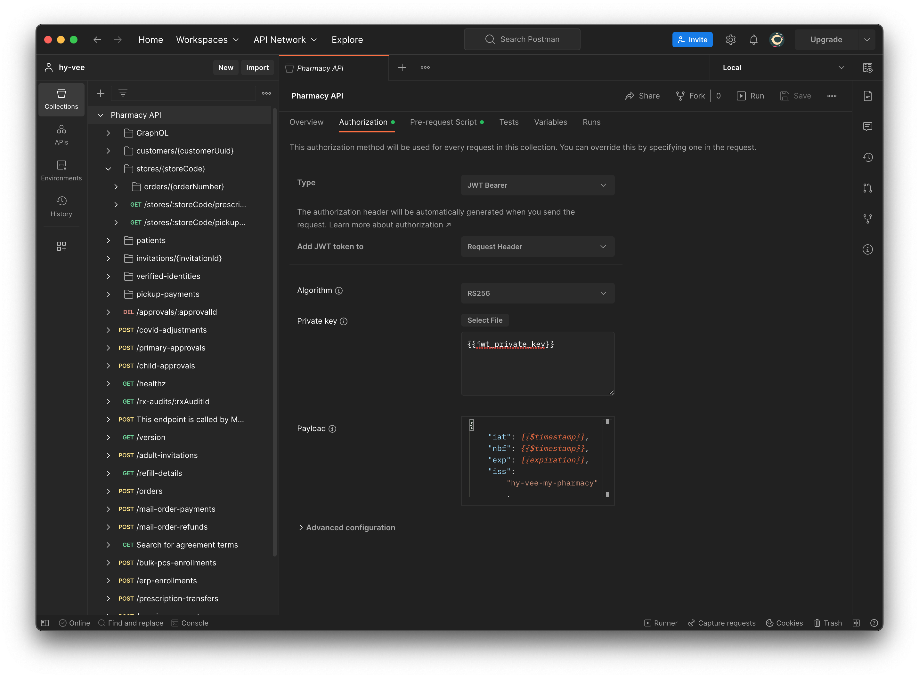

Authorize
All the Things!
Notes:
It gets even better though. Collections also let you define things for the entire collection, like a default authorization scheme. Remember this, because this is how you do automatic authorization!

Slide 28
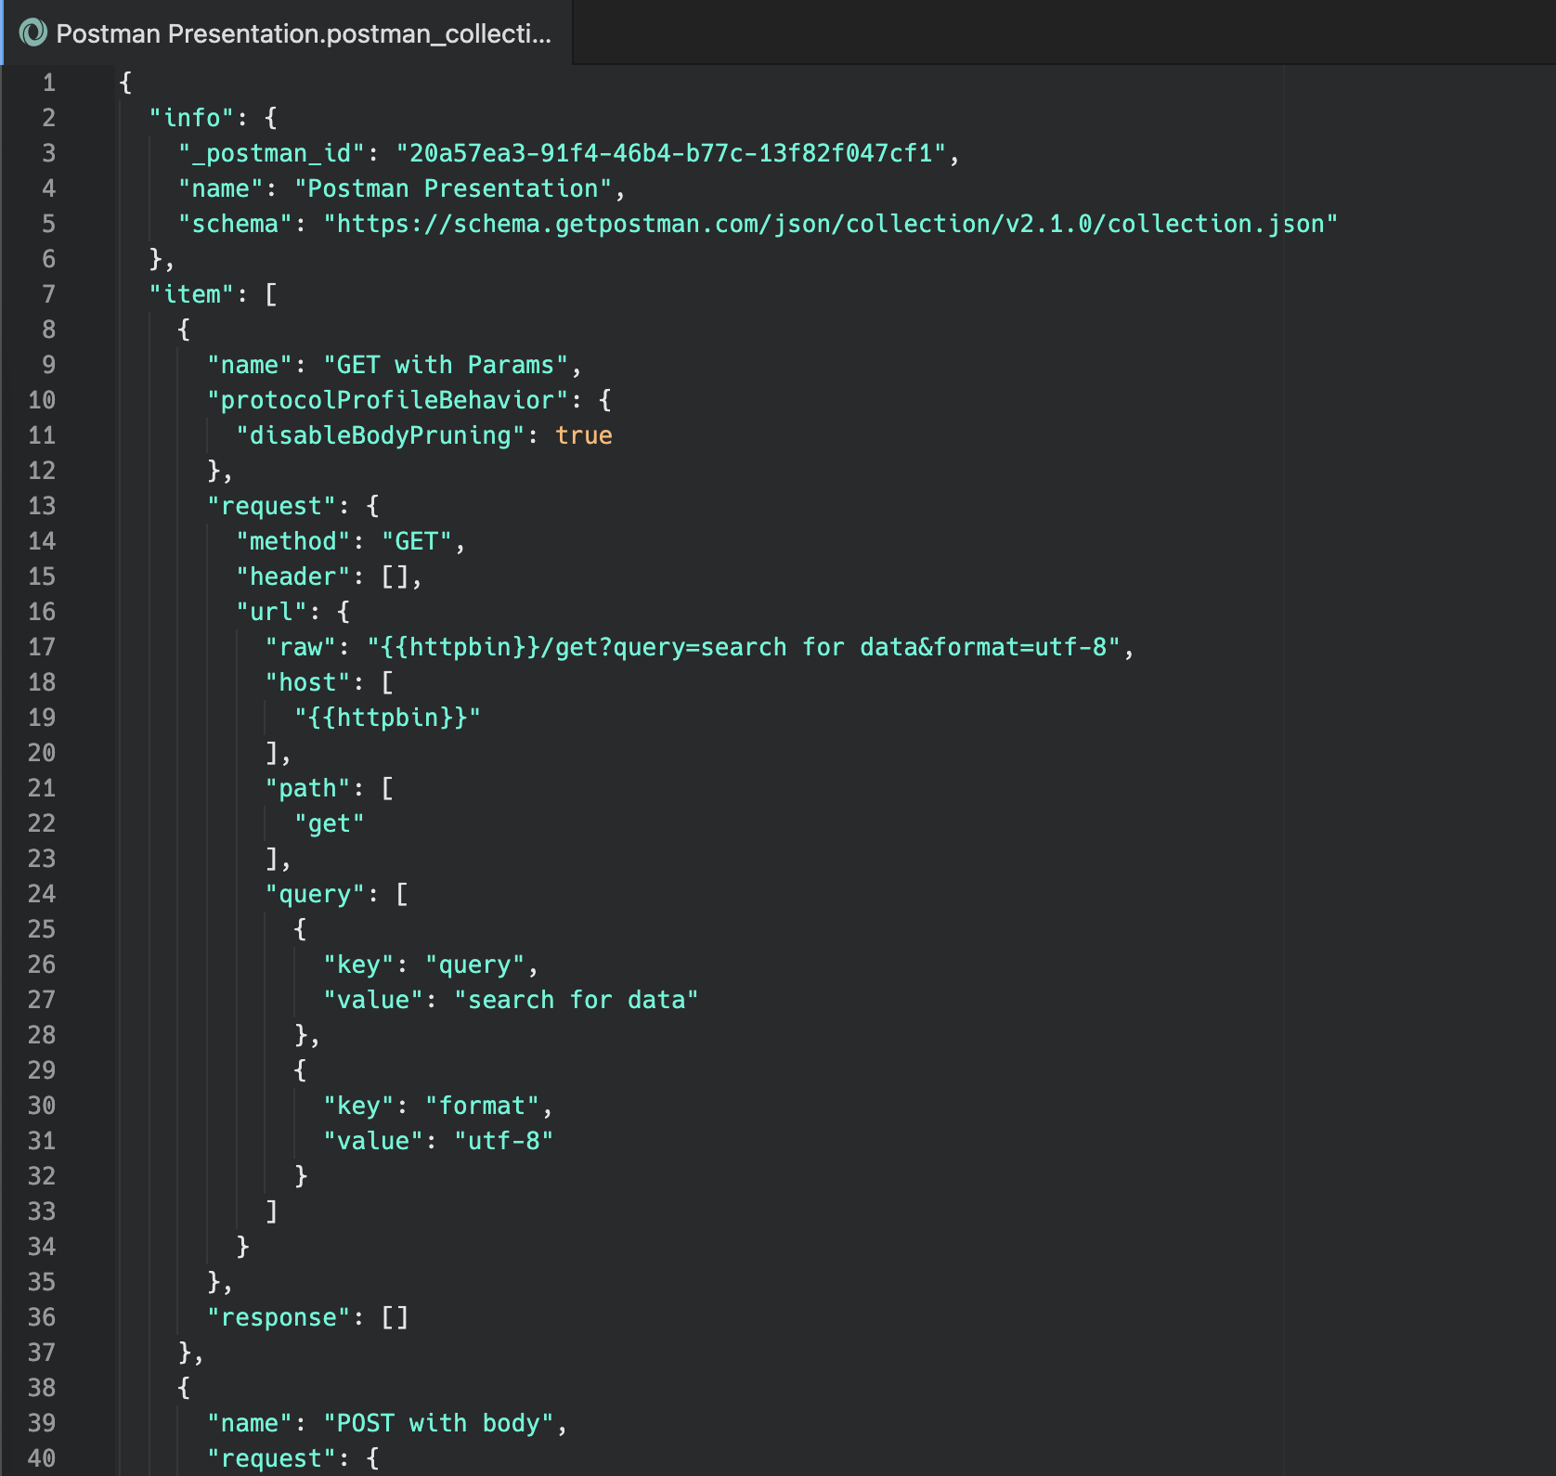
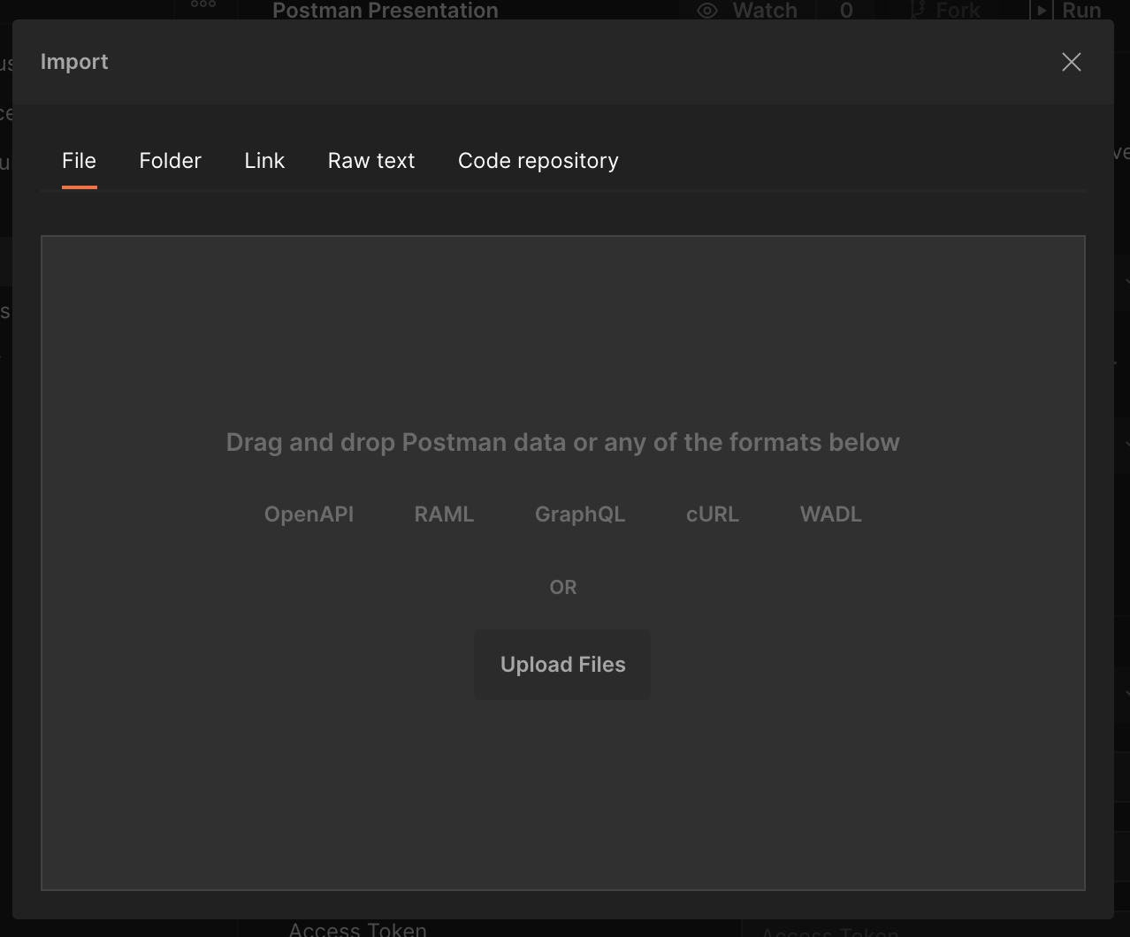
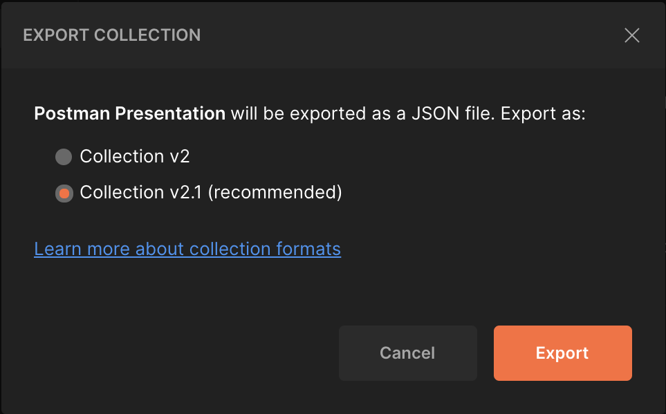
Notes:
Did I say it gets even better? Because it gets still better than that. You can import and export collections to JSON files. That makes them super easy to share around. I even have a github repository called pharmacy api postman with all the collections I’ve put together for Health and Wellness. I’ll put a link on the last slide.

Slide 29
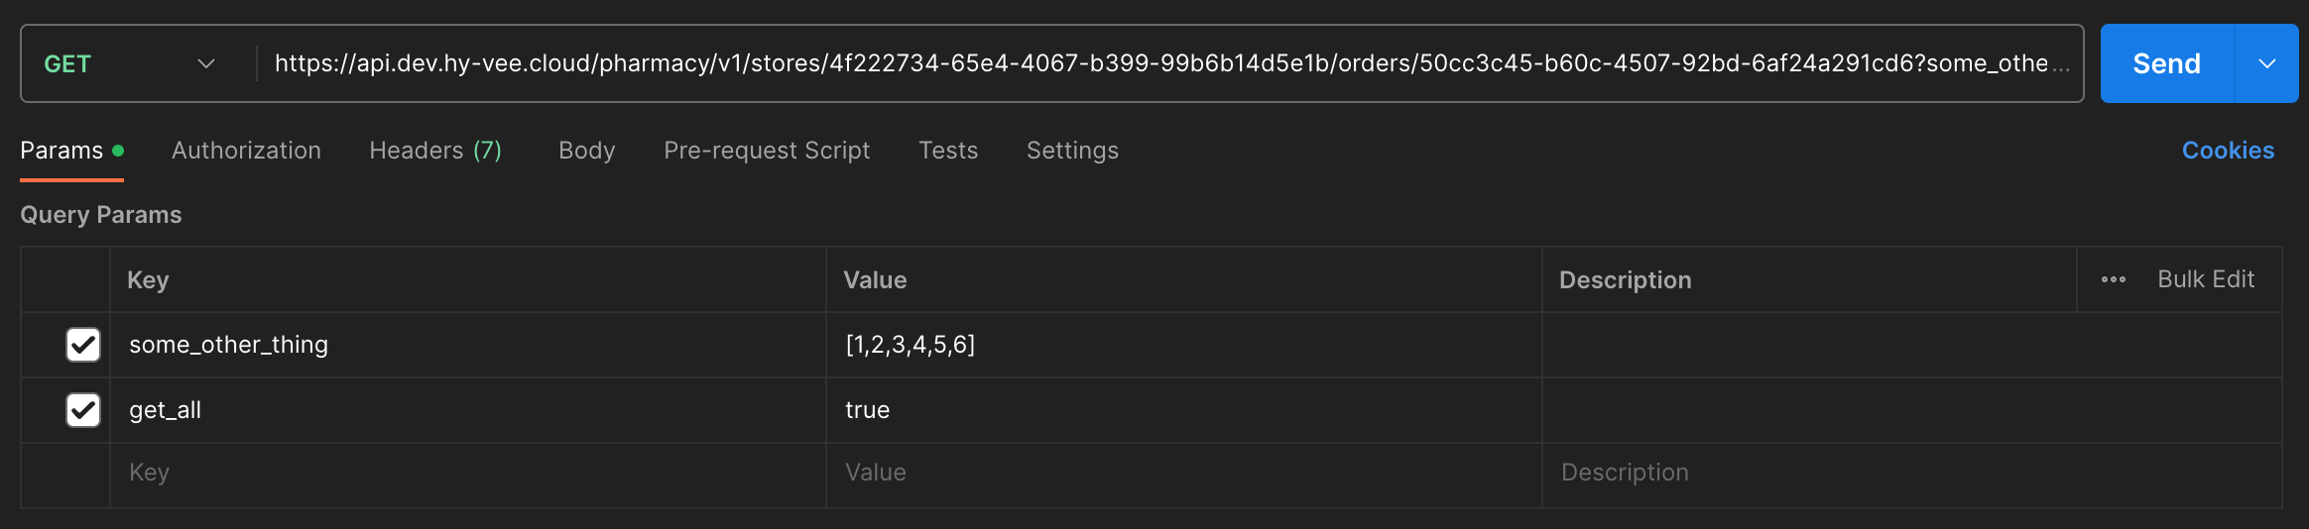
This is a lot to
copy and paste
Notes:
Okay, so we’ve got this HTTP thing down, made a few requests, put them into a collection, what’s next? Well, it’s getting really annoying having to copy paste these long public API URLs around everywhere. It sure would be nice if we could store them somewhere and refer to them.

Slide 30
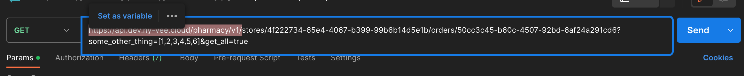
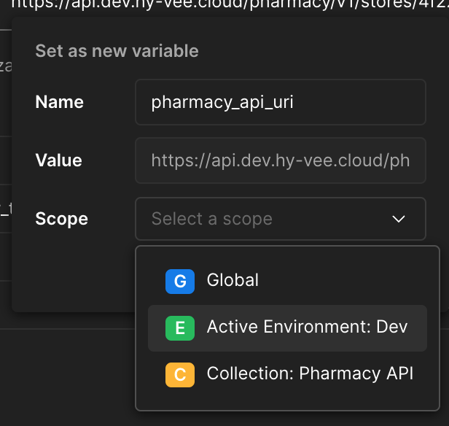
Saving a
Variable
Notes:
Let’s see, if I highlight that base domain… what’s this? Set as variable? And I can scope it globally, or to my collection, or to… an environment? What’s an environment?

Slide 31
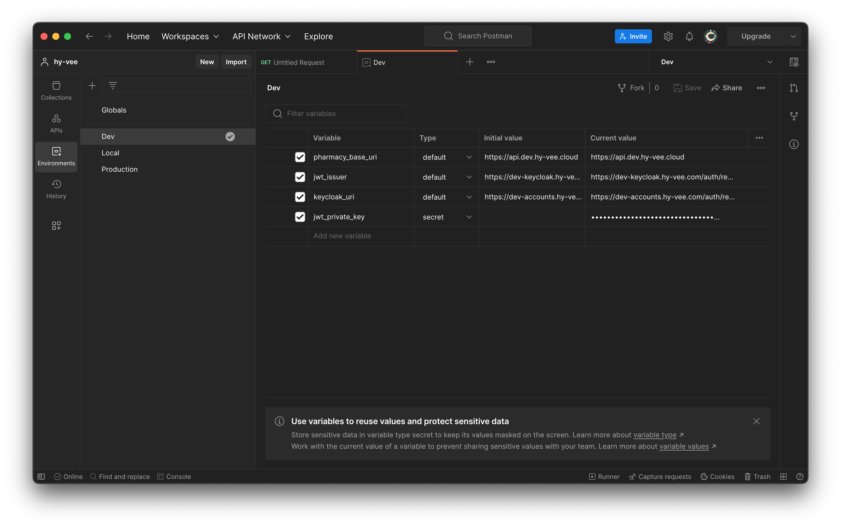
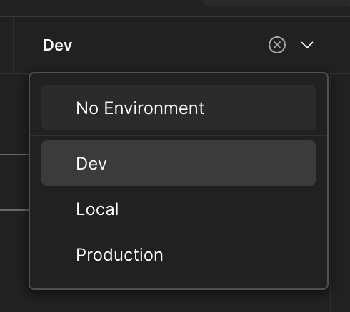
Environments
Notes:
Environments give our collections superpowers. With an environment set up, you can have a single variable that means different things depending on what environment you’re in.
You’ll probably notice that all these environment variables have an initial and a current value. That’s because environments can be exported too, and you don’t want to put your production secrets in plaintext when you share your environments with a friend. The current value is what postman uses; the initial value is what gets exported. They’re the same unless you make them different.

Slide 32
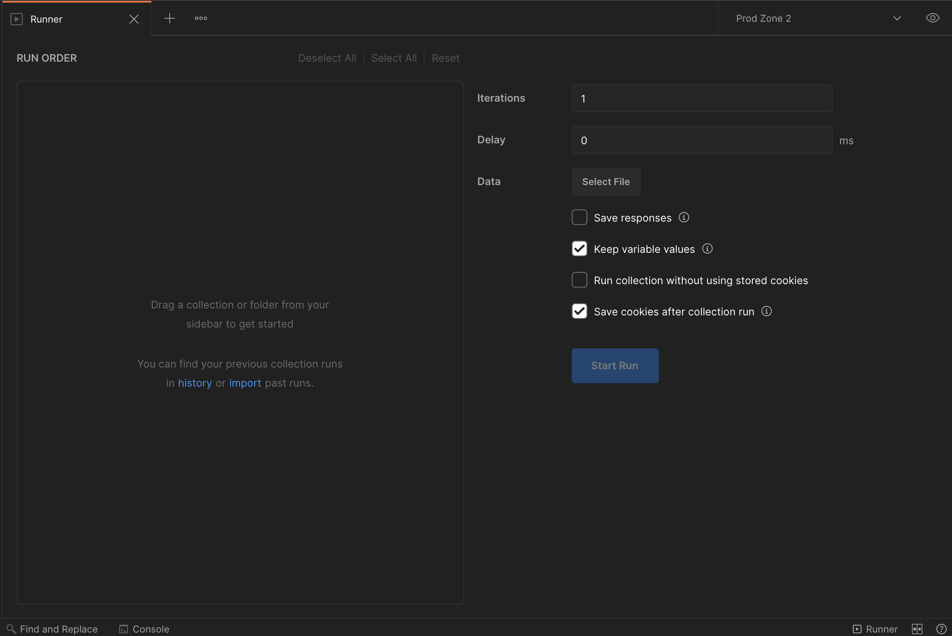
Testing with the Runner
Notes:
Okay, so our collection is variabled up. We’ve got 200 requests in there, and it’s super easy to run them one by one. You could use them as a nearly automated integration test.
You see that little status bar item in the bottom right corner that says “Runner”? If you click it, you get this screen.

Slide 33
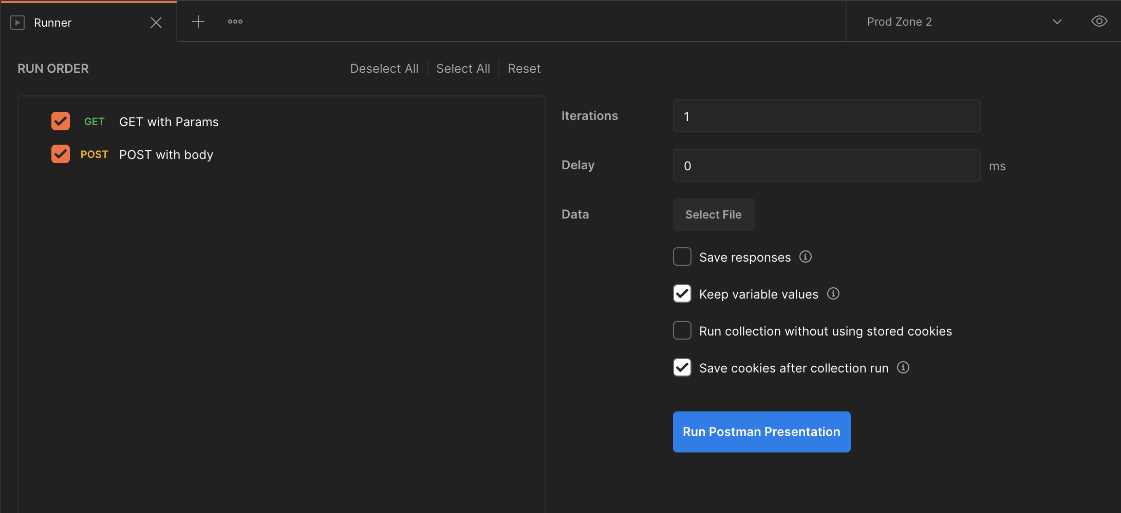
Add a Collection…
Notes:
Add a collection and you’re off to the races. Just press that Run button.

Slide 34
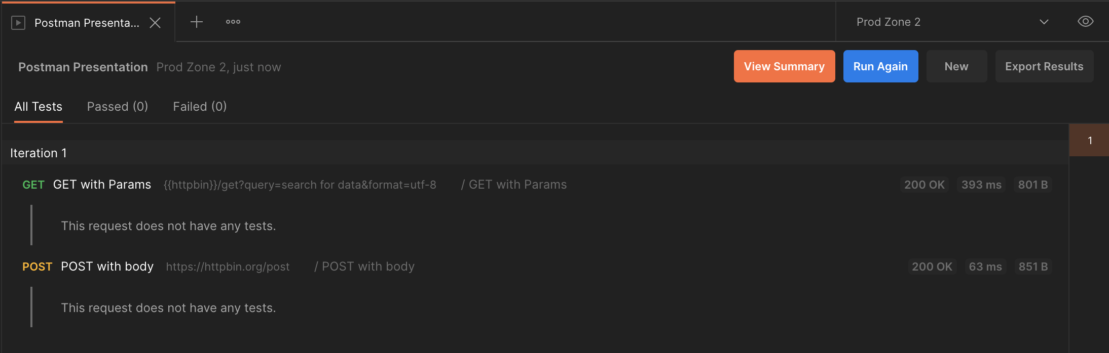
…and press Run
There is no third step
Notes:
Boom. One click testing that took no time at all to set up, using the requests you already have from your manual testing.
But Caleb, that’s not automated testing. One click is still one click. I want to set this up in my continuous integration pipeline and never touch it again.

Slide 35
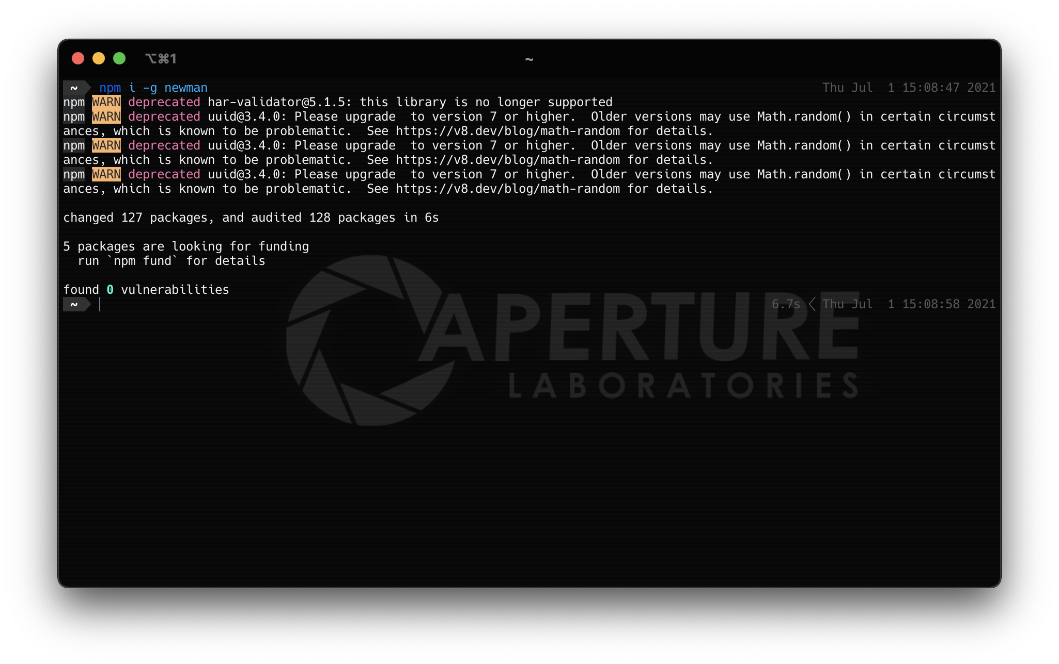

Notes:
Fair enough, I did promise you that we’d automate this.
Once you’ve got node, you’ve got npm. Run `npm i –g newman` (or `yarn global add newman` for those that prefer it) at that terminal and grab the NPM package Newman. The `i` is for install, the hyphen g is for globally.

Slide 36
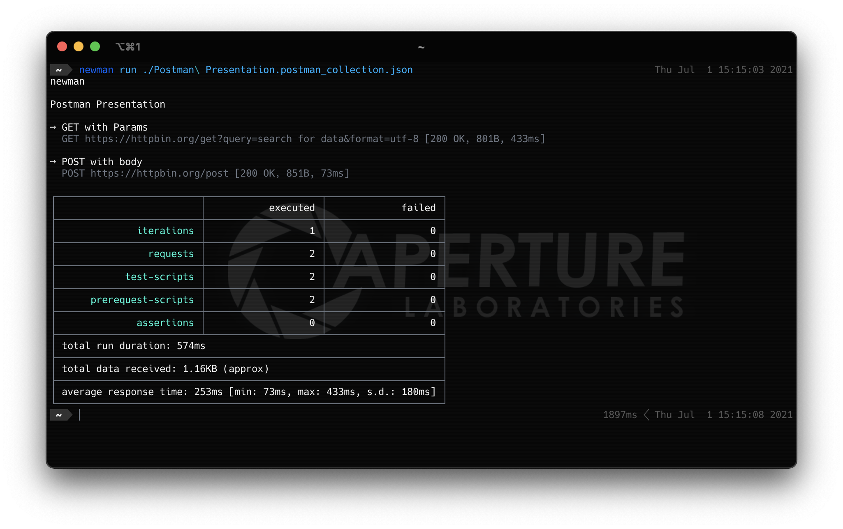
Notes:
Newman does what we just did in postman, but on the command line. It can print your results to the screen, it gives the correct response codes for CI, and it can even export your results as JSON if you want to write an integration like a github hook.

Slide 37



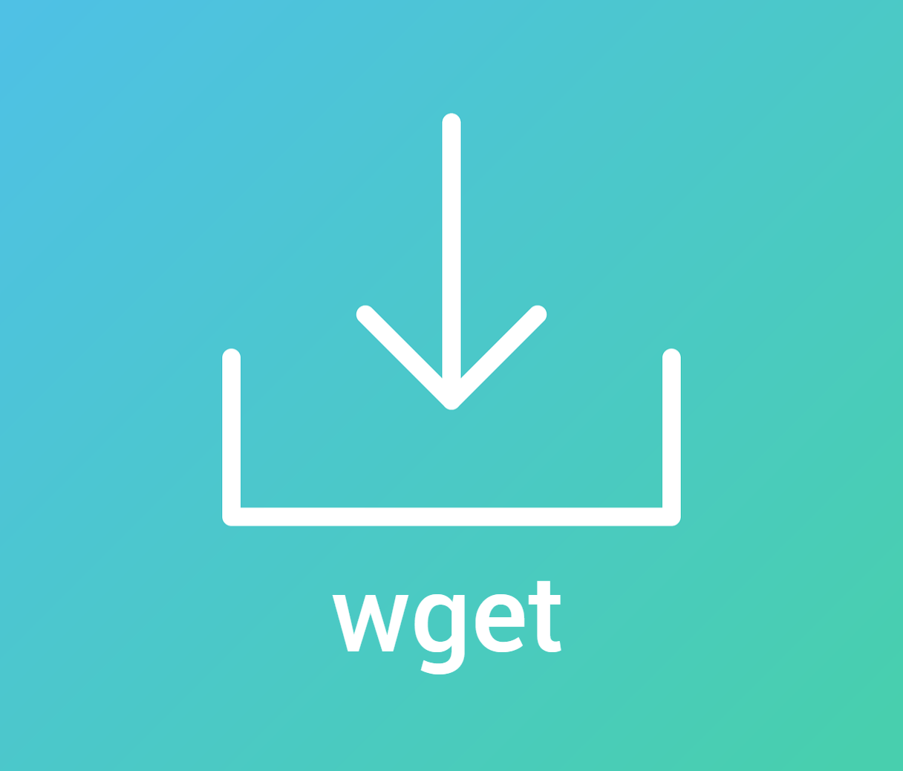


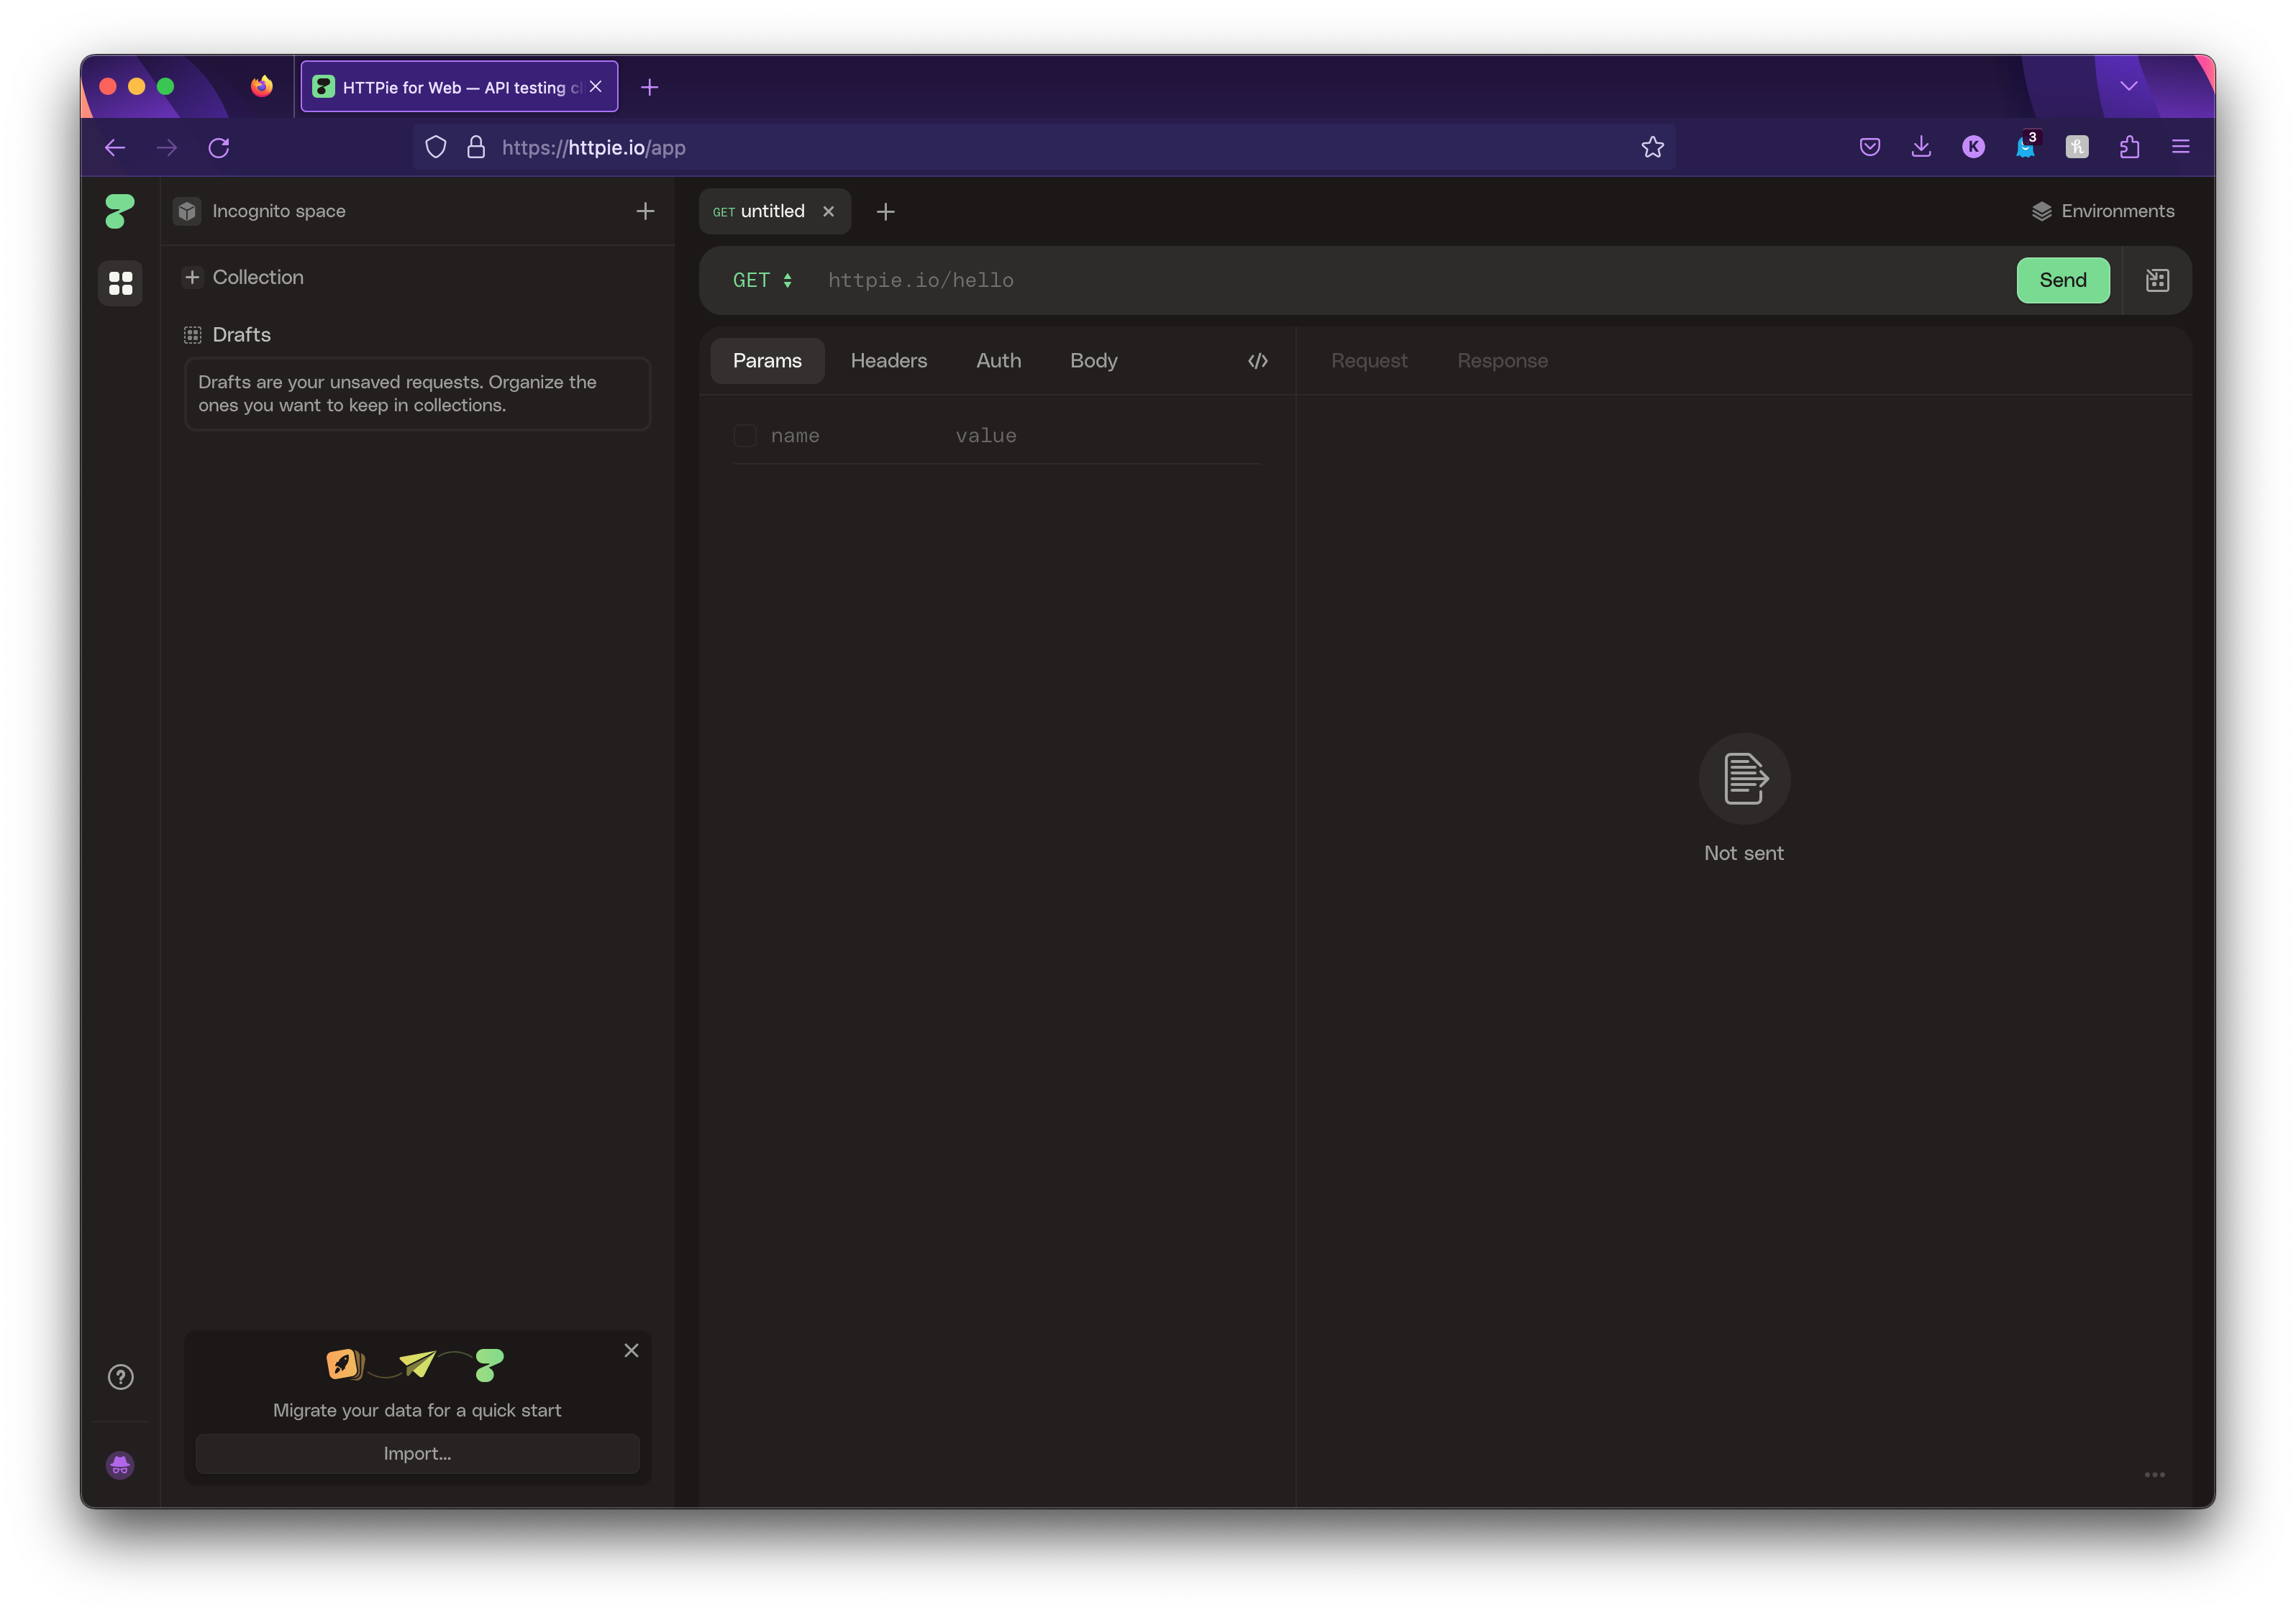
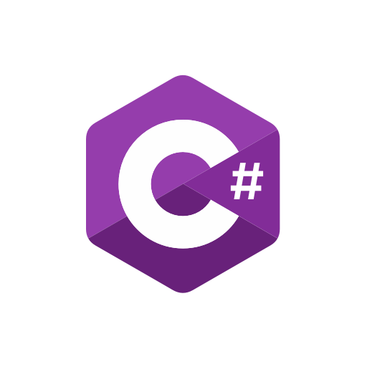
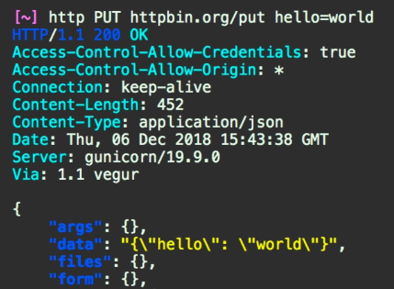

The Competition
httpie.io
Notes:
But Postman is not the only app or CLI that lets you make requests.
If you’re in a programming language, there are almost always built in libraries for making requests.
Outside of code, on the command line, cURL and wget are the de facto standards. If you’re looking for more, I like the python package HTTPie, which adds nice syntax highlighting and an easy interface.
If you’re looking for more GUIs, HTTPie has one… but there’s another big player already in use here at Hy-Vee.

Slide 38
Notes:
Insomnia was created back in 2016 by the API company Kong as an alternative to Postman. It’s developed in the open on github and has a thriving ecosystem of plugins.
Because it’s more open than Postman, it has no reason to withhold features like automatic syncing for paying customers. Let’s take a look:

Slide 39
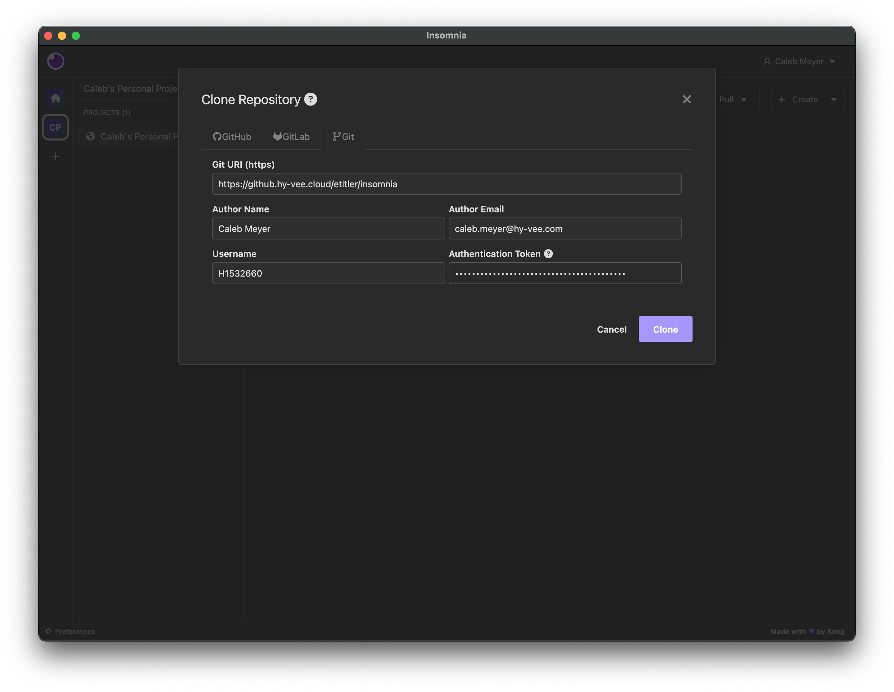
Syncing is
Easy!
Notes:
Syncing in insomnia is as simple as adding a git repo to your existing collections, or adding your collections from an existing git repo. The hardest part is generating the auth token, which github makes easy.

Slide 40
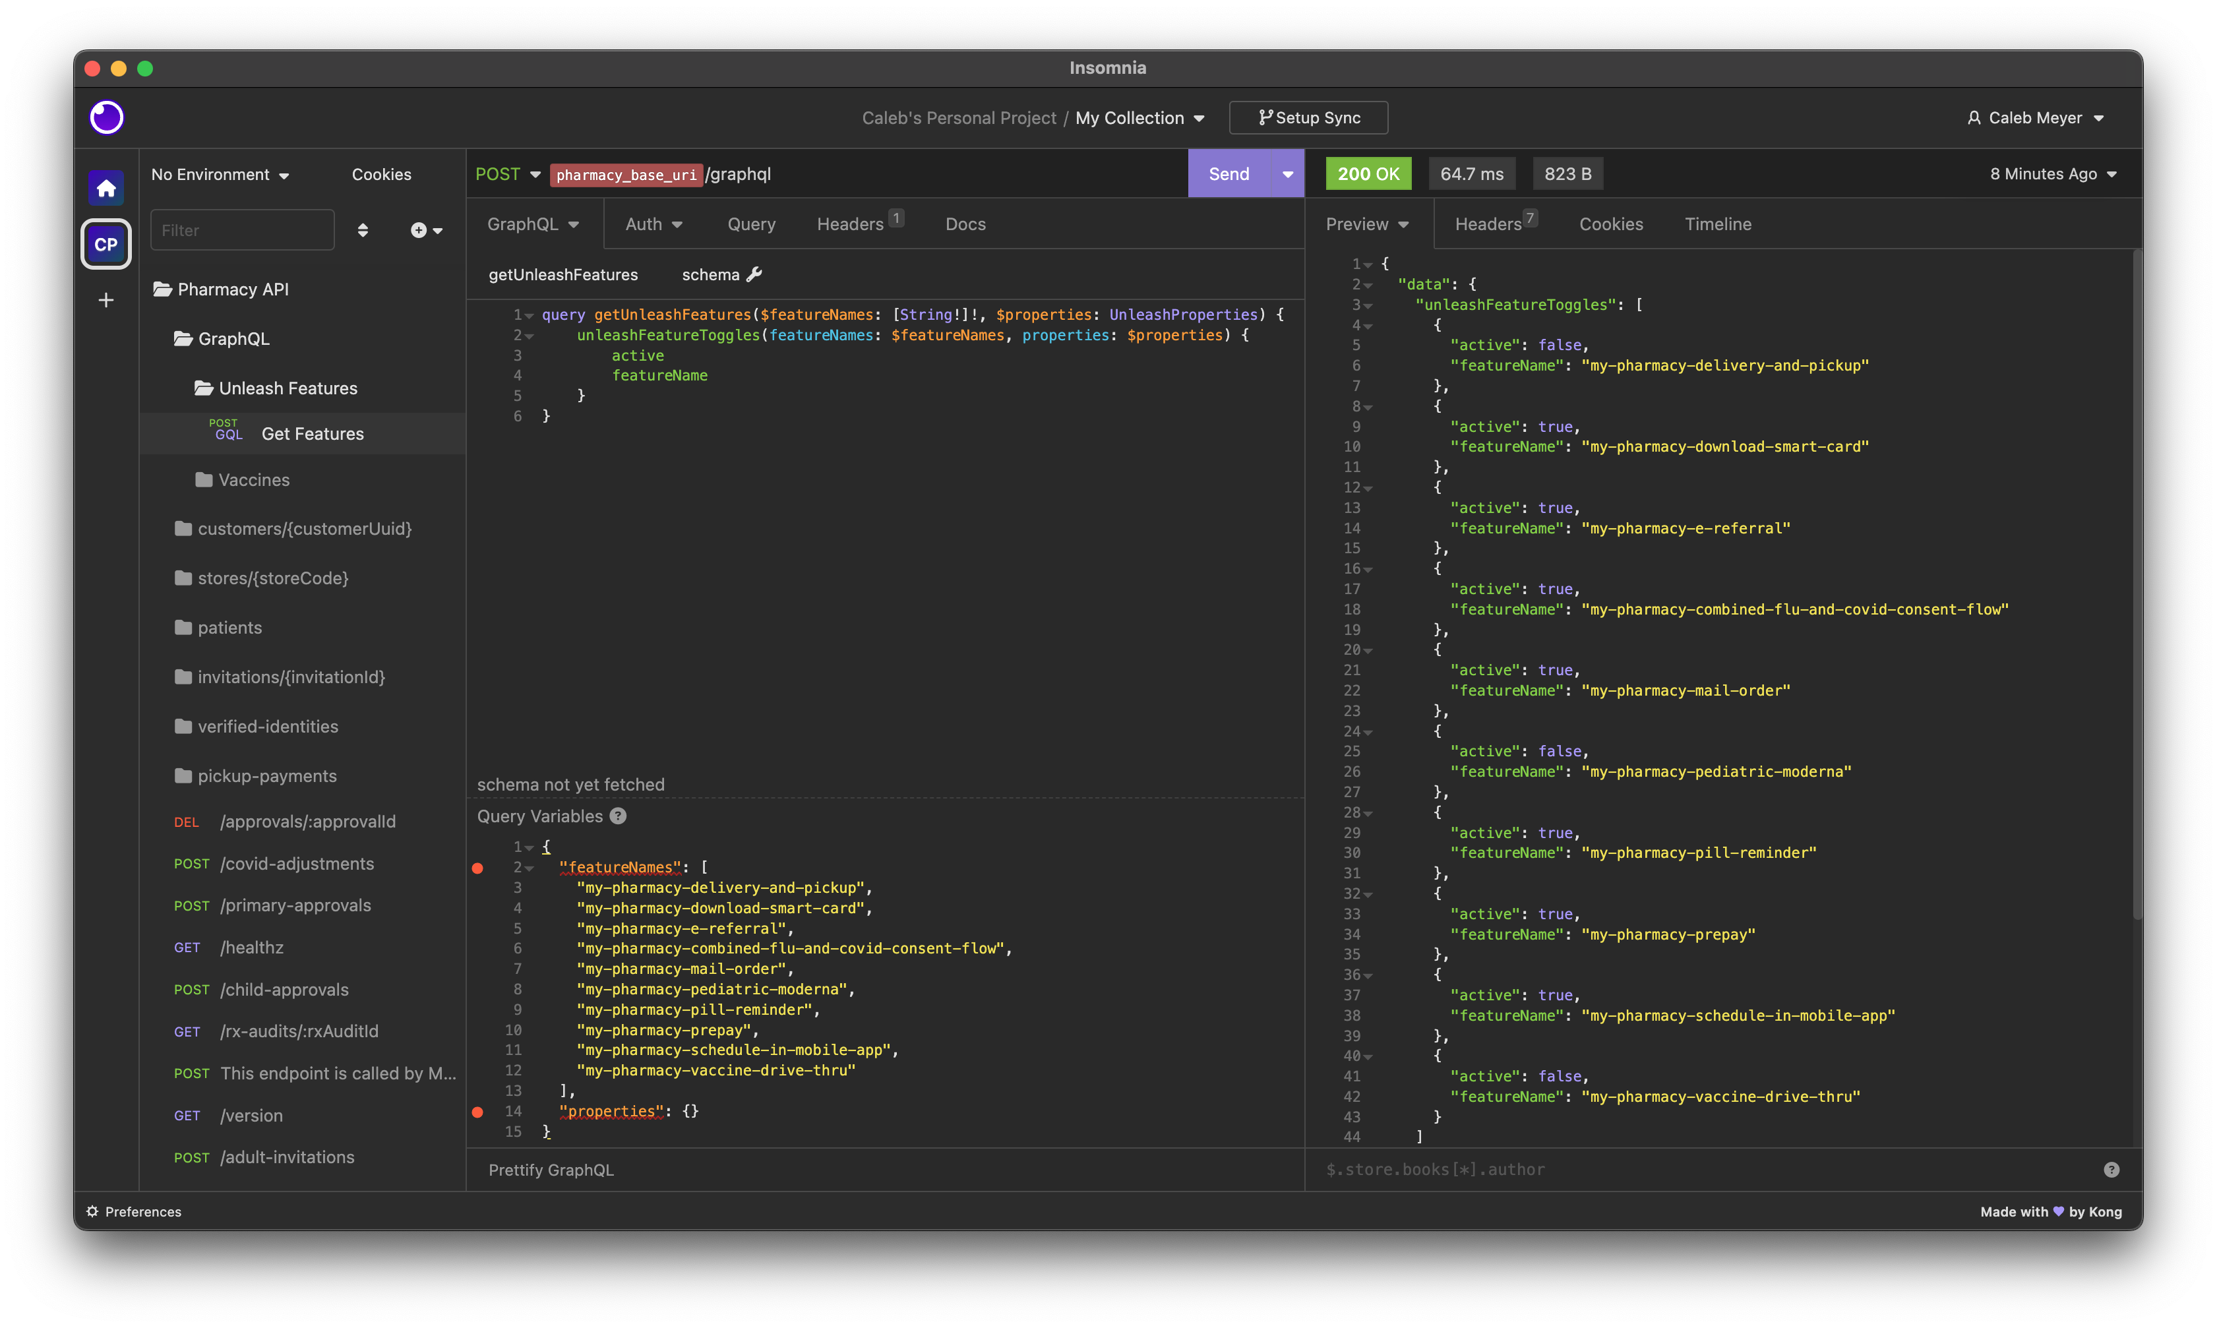
I’m not sleepy, I’m not sleepy, I’m not….
Notes:
Just like in postman, you have collections, variables, and environments. Both have great out of the box support for GraphQL as well. Just like newman, Insomnia has a command line tool, `inso`. I even found that Ethan Titler has a set of collections for it already on our GitHub!
So why don’t I use it?

Slide 41
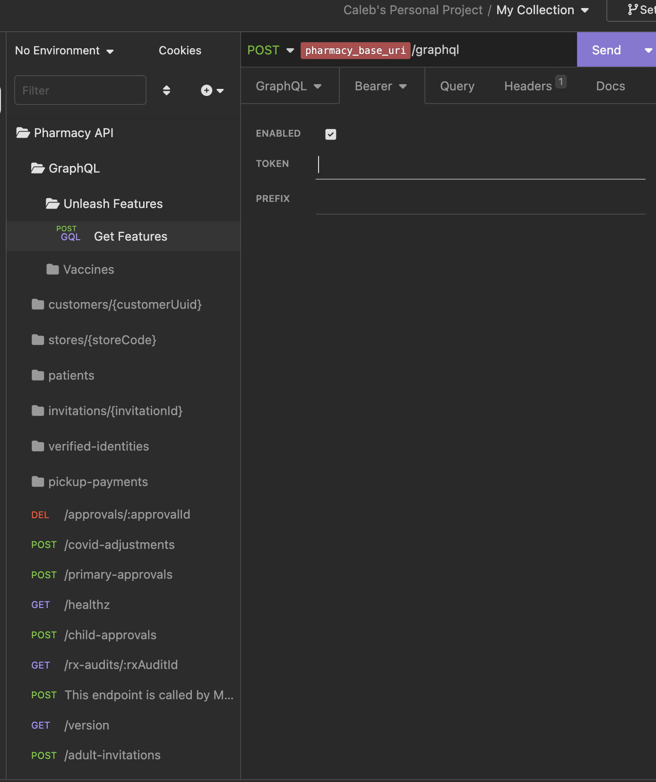
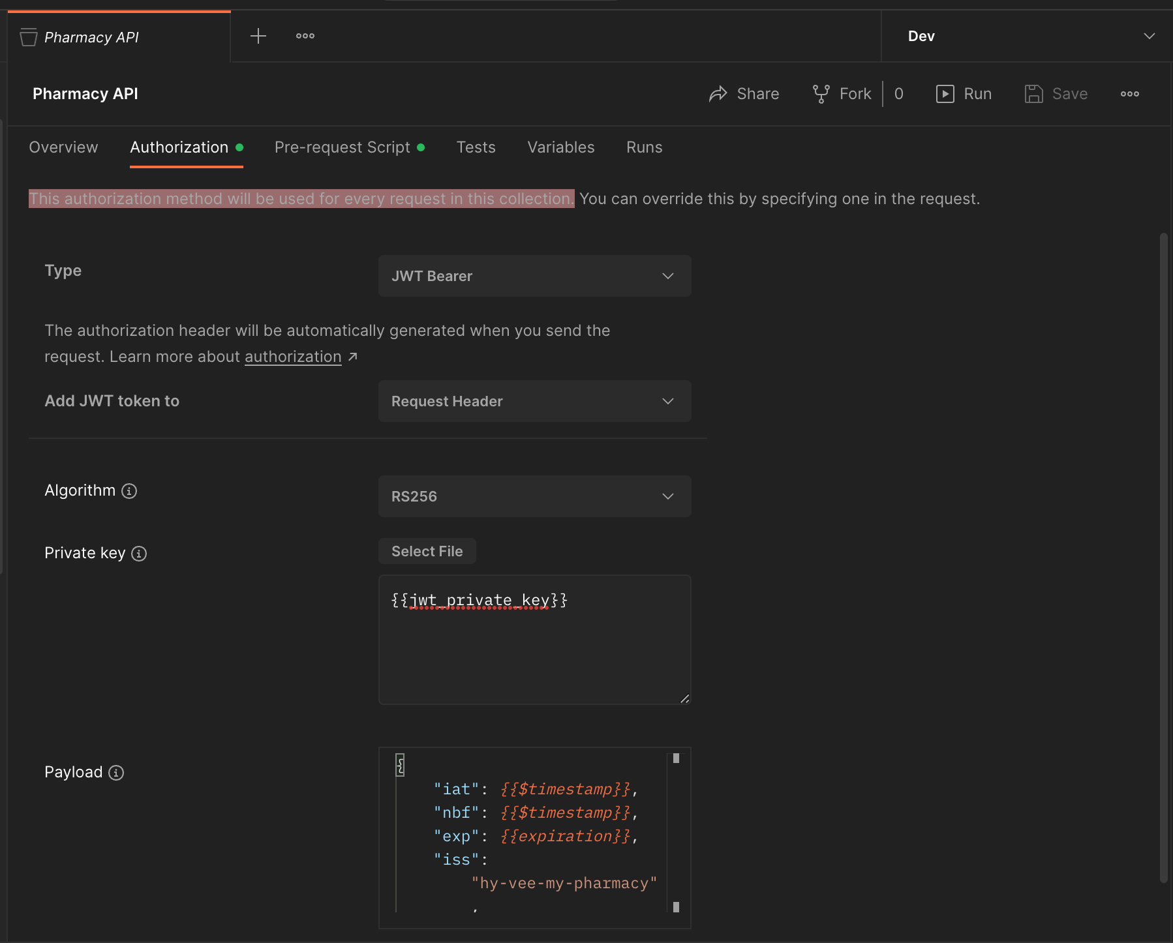
Notes:
It’s a lot of small things that all add up. First, you can’t do things per collection or folder in insomnia. There are no collection variables, and you can’t use a collection wide auth (that I have found).
Speaking of auth, postman will auto-generate a jwt for you. As far as I can tell, insomnia can’t, or might be able to with a plugin if you know how to use it.

Slide 42
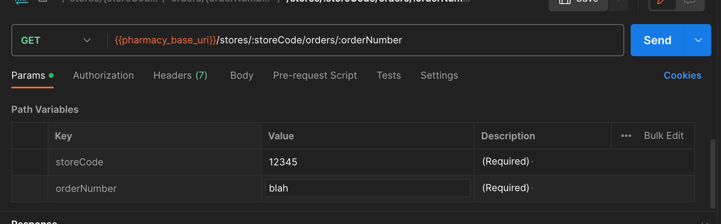
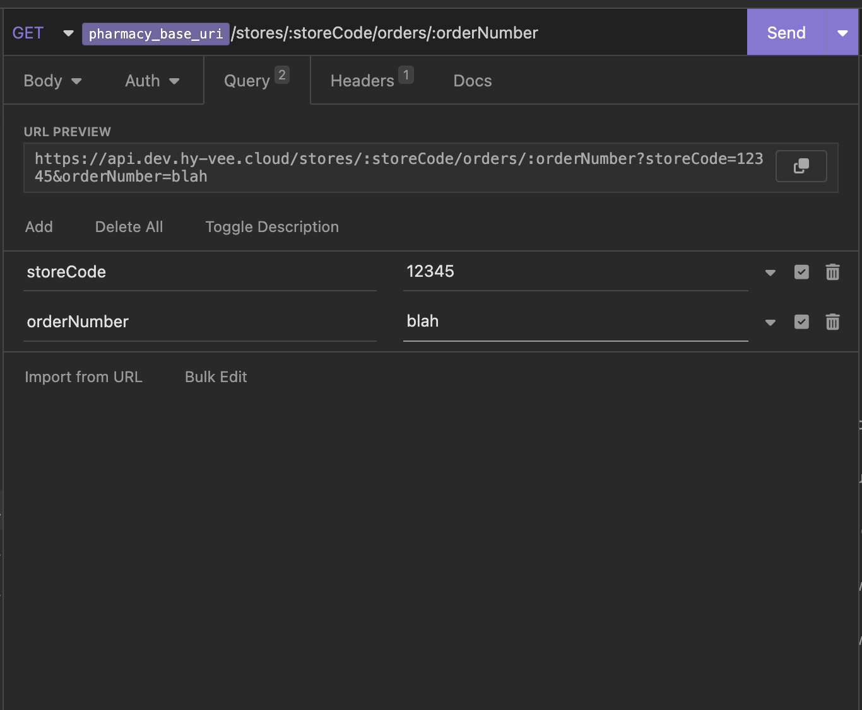
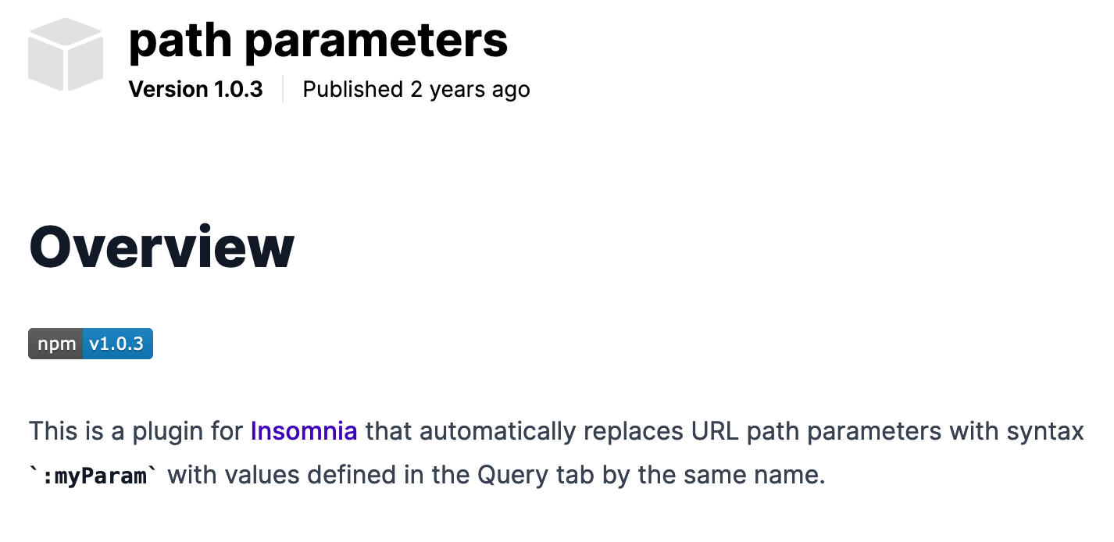
Path Parameters
Notes:
Second, many of our APIs use path variables instead of query parameters. In postman, this is supported directly. In insomnia it requires a plugin and you’re not sure before you send the request if you got the params lined up.

Slide 43
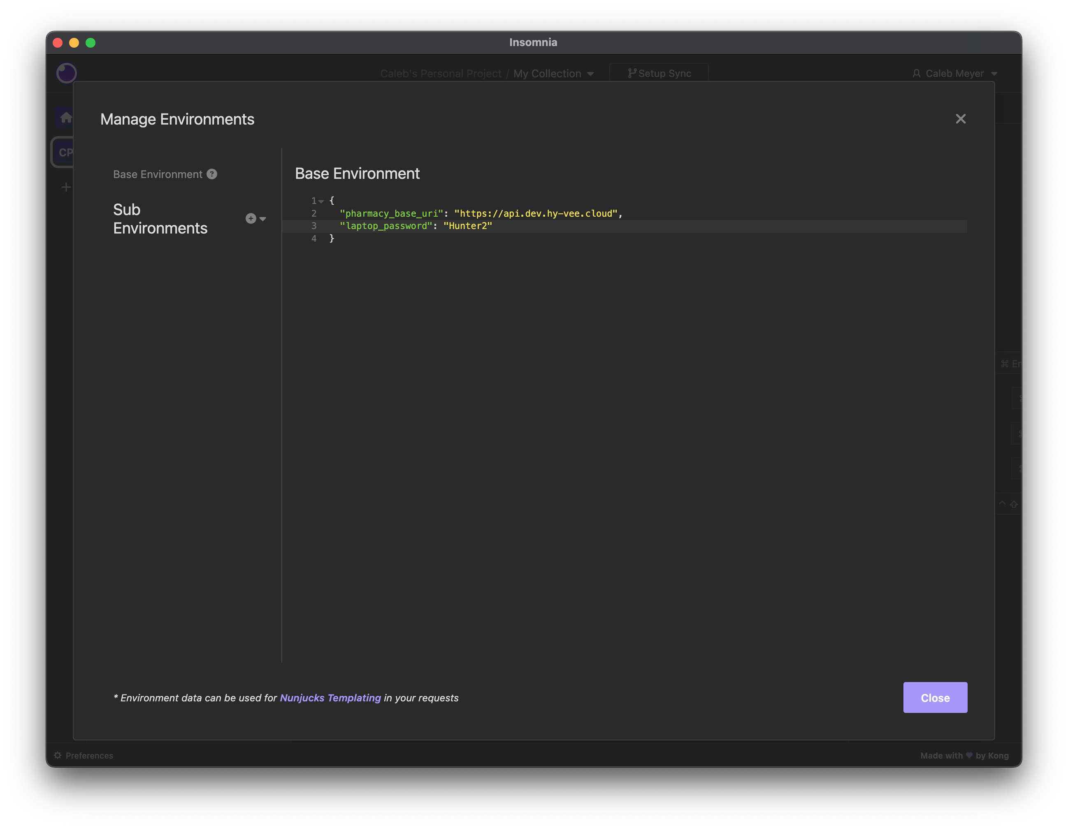
Pls no hax 🙏
Notes:
Third: Environments in Insomnia don’t have a friendly GUI for editing them. You have to manually type in JSON. That part’s not so bad, but it also means there are no secret variables. Anything in the environment is plain text.

Slide 44
Questions?

Slide 45
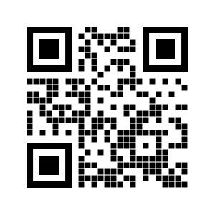
THANK YOU!
Links:
https://github.hy-vee.cloud/pharmacy/pharmacy-api-postman
https://github.hy-vee.cloud/etitler/insomnia
Fonts used in this presentation:
Orbitron
Courier Prime
Ubuntu
Bradley Hand ITC
Merienda
Slides can be found at
bit.ly/caleb-on-postman
Color Scheme (thanks coolors.co):
Background #343838 (cool gray)
Foreground #FFFFFF (white)
Accent 1 #005F6B
Accent 2 #008C9E
Accent 3 #00B4CC
Accent 4 #00DFFC
Accent 5 #E64823
Accent 6 #EE7547 (Postman orange)
Notes:
And that’s all! Thanks everyone for coming to my tech talk. I’ll be around on slack if you have any more questions at all. You all rock!

